Slide 1
Research Summary

Slide 2
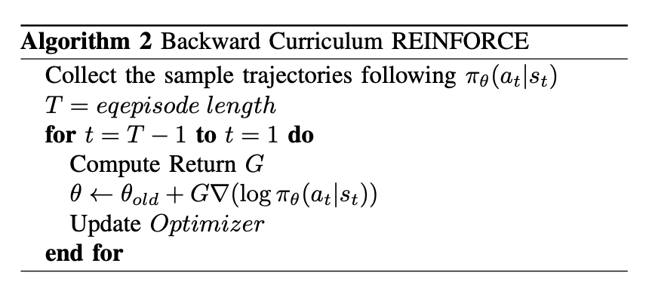
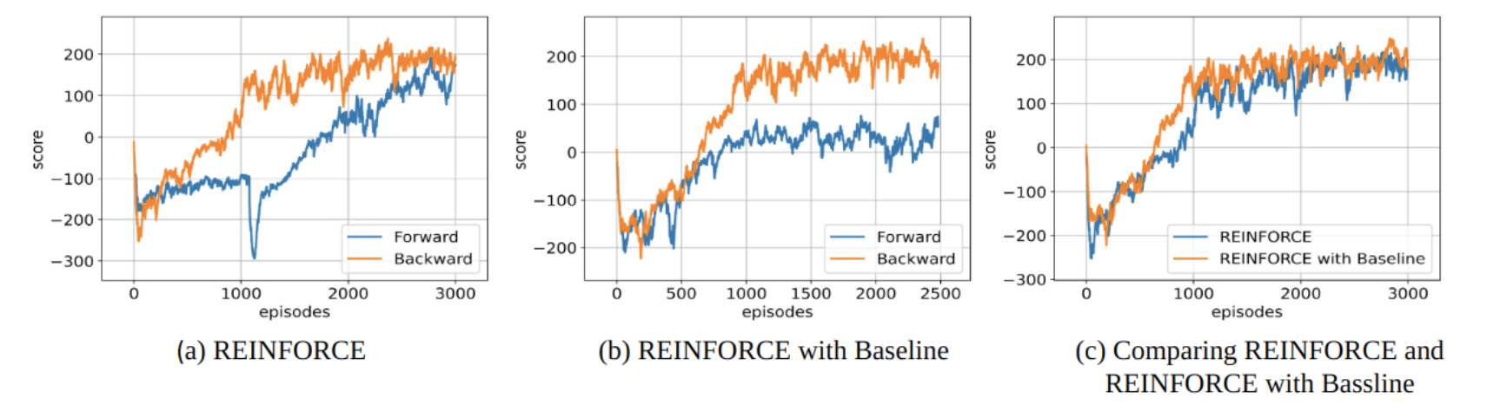
Reinforcement Learning
During NSF summer research internship at Georgia Tech advised by Siva Theja Maguluri, I published paper “Backward Curriculum Reinforcement Learning”[18].
This paper was motivated by the observation that the natural reward distribution near the end state is denser than at the initial state. Therefore, I leveraged the reversed trajectory to replace the original sparse reward function with a strong reward signal.
Below figure shows that backward trajectory is more sample efficiency.
Figure. Algorithm
Figure. Experimental result on Lunar lander environment

Slide 3
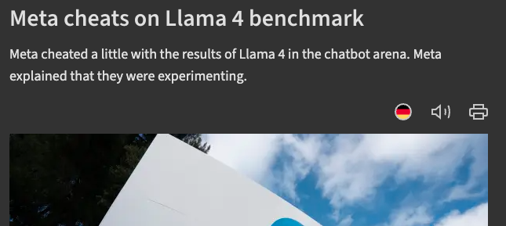
LRM Benchmark contamination
Motivation: Leaderboards for large reasoning models (LRMs) have turned evaluation into a competition, incentivizing developers to optimize directly on benchmark suites. [0]

Slide 4
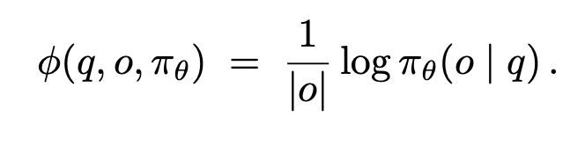
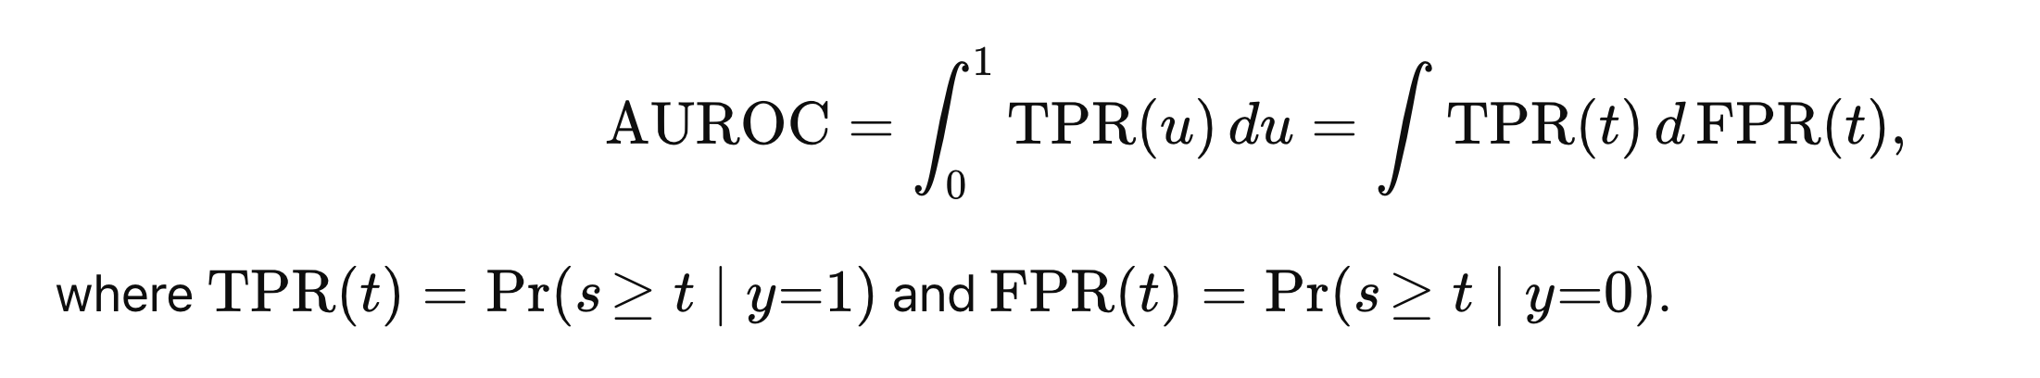
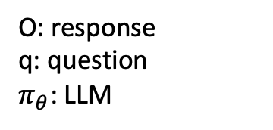
LRM Benchmark contamination
Experiment setting: We contaminate the LLM by only using half of the benchmark (member set ) and leave other half of the benchmark (non-member set) without using for training. Benchmarks including: AIME24,25, MinervaMath, Olympiad Bench, GPQA-Diamond, AMC23.
Detection methods: we use 10 representative contamination detection methods and most of them are membership inference attack (MIA). Which uses average log prob of response to get score, and it is higher than certain threshold, we consider this as member.
Detection metric: We use AUROC since detection rate depends on certain threshold, so we need to check various thresholds.
O: response q: question $π_{θ}$: LLM

Slide 5
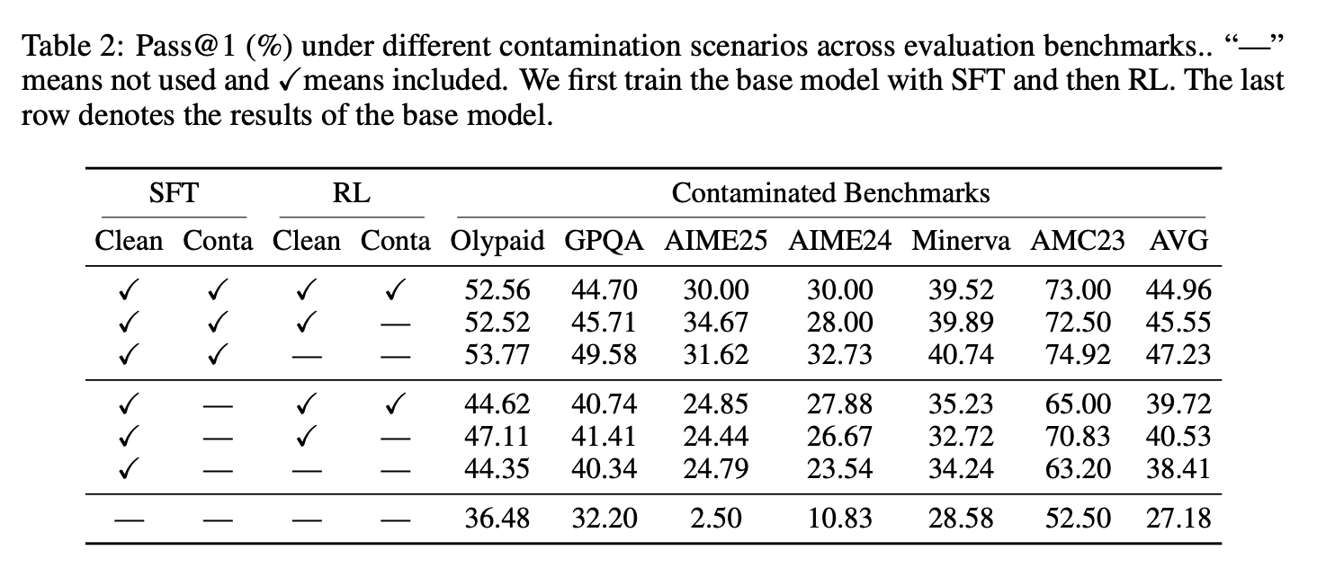
LRM Benchmark contamination
Findings 1: Contamination happens when the base model evolves into LRMs.
We observe that training from base model to reasoning model using long CoT distilled from QwQ32B, it can inflate the performance a lot while RL doesn’t show any performance improvement. We use GRPO implementation from Verl.

Slide 6
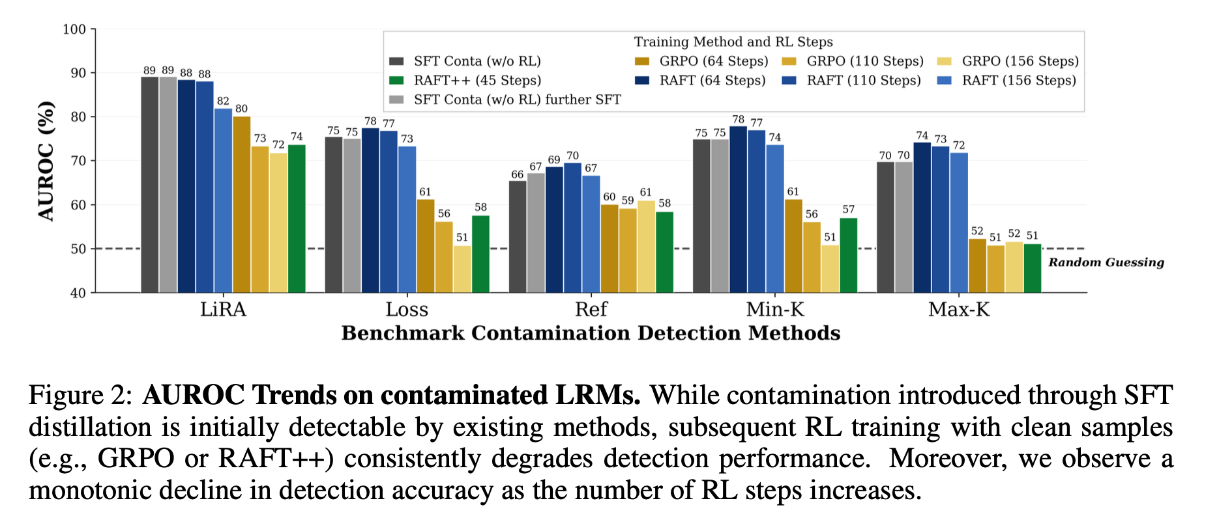
LRM Benchmark contamination
Findings 2: More GRPO conceals the contamination evidence.
Interestingly not all RL algorithm conceals it (ex RAFT).

Slide 7
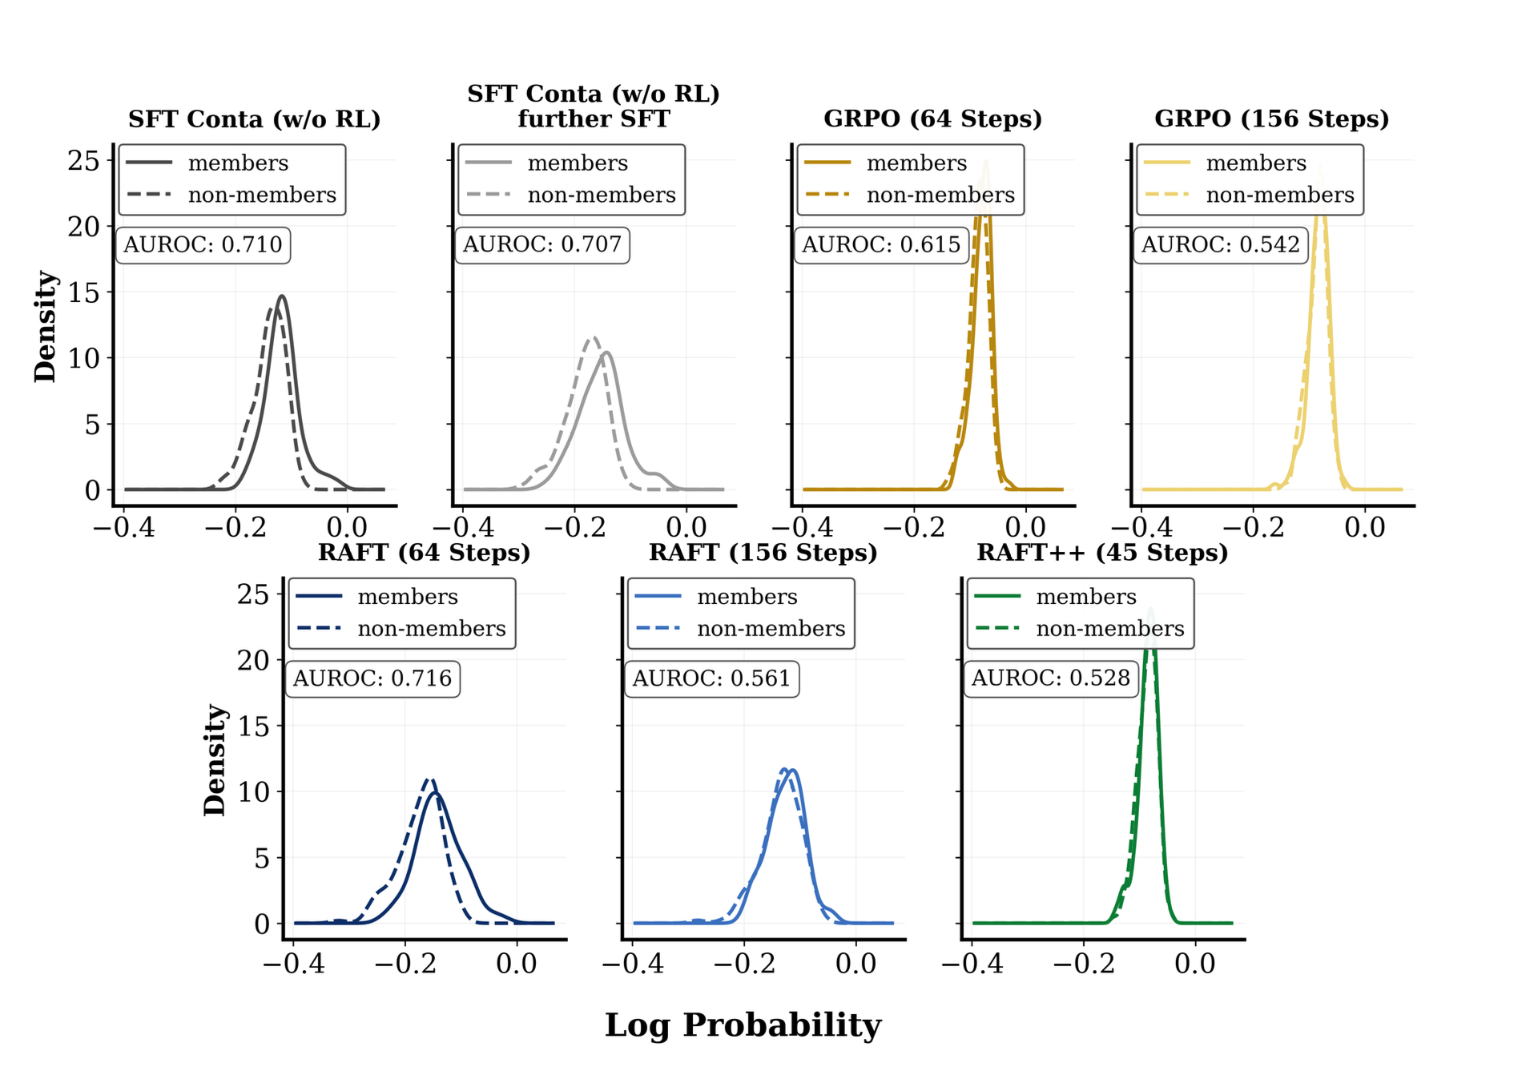
LRM Benchmark contamination
Motivation for theoretical analysis: we observed that NLL distribution of member and non member collapse after GRPO while RAFT still separates
So what is underlying factor that conceals the contamination?

Slide 8
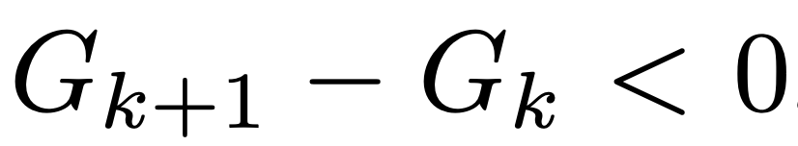

LRM Benchmark contamination
We focus on analyzing the gap G_k of negative log likelihood for members and non-members on correct samples (i.e., r = 1) since it shows that when gap contracts NLL distribution for member and non member become closer, thus concealing happens.
K: step r=1: correct sample N: non member M: member l: NLL

Slide 9
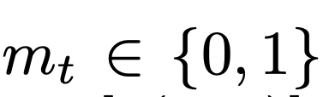
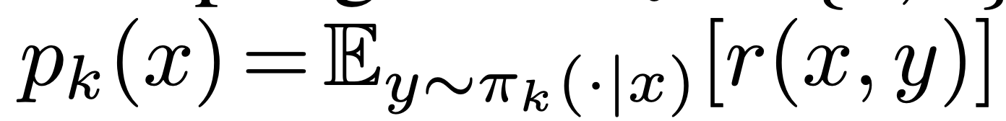


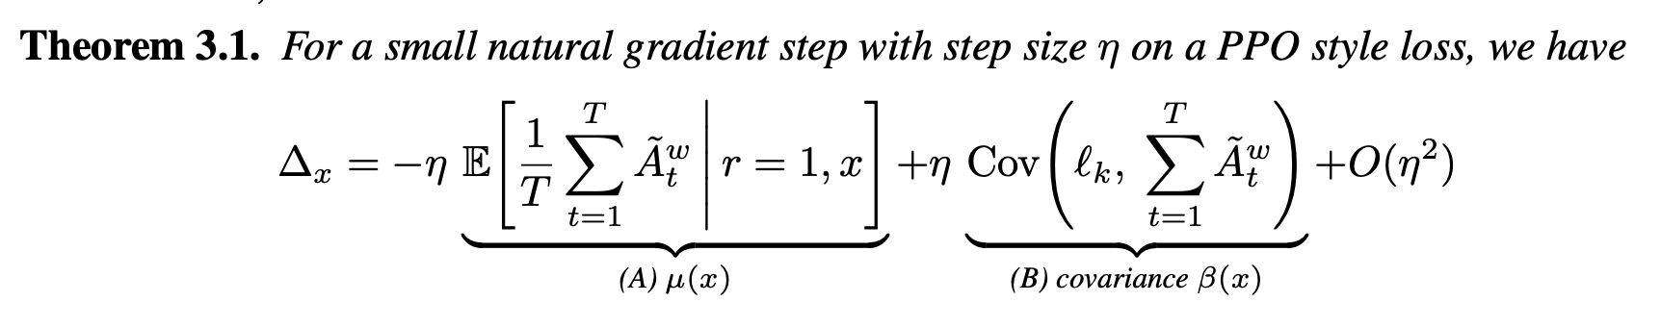
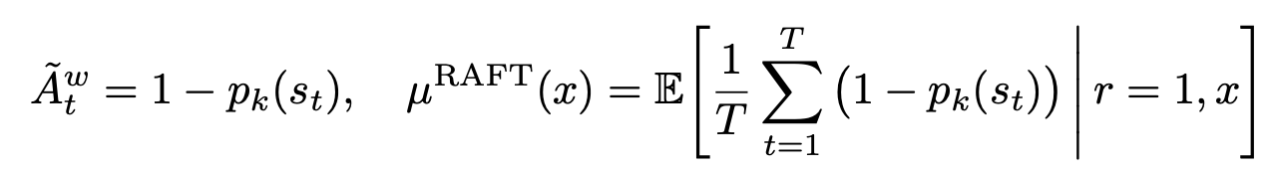

LRM Benchmark contamination
We derive the natural gradient step
Why RAFT cannot conceal? The gap is positive because covariance gap offset the mean gap

Slide 10
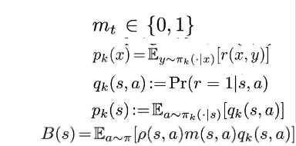

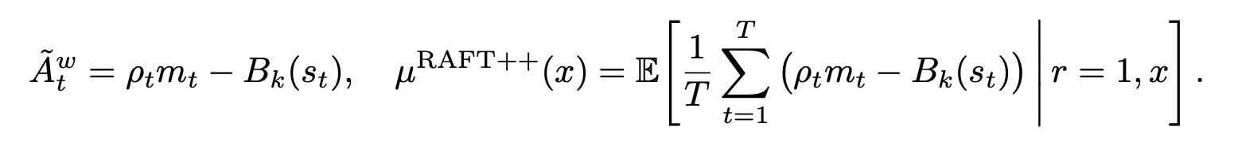
LRM Benchmark contamination
Why RAFT++ and GPRO can conceal? The gap is negative. First, mean gap is small due to clipping, so we can ignore this fact. Second, covariance gap is negative due to first covariance term is large negative on non member. The non member trajectory have high variance l_k due to uncertainty and this term is smaller due to more likely to get clipped due to large push, thus result into large negative covariance than member. Key is clipping!
Notes:
(we can ignore second cov term since it is relatively small due to avging actions)

Slide 11
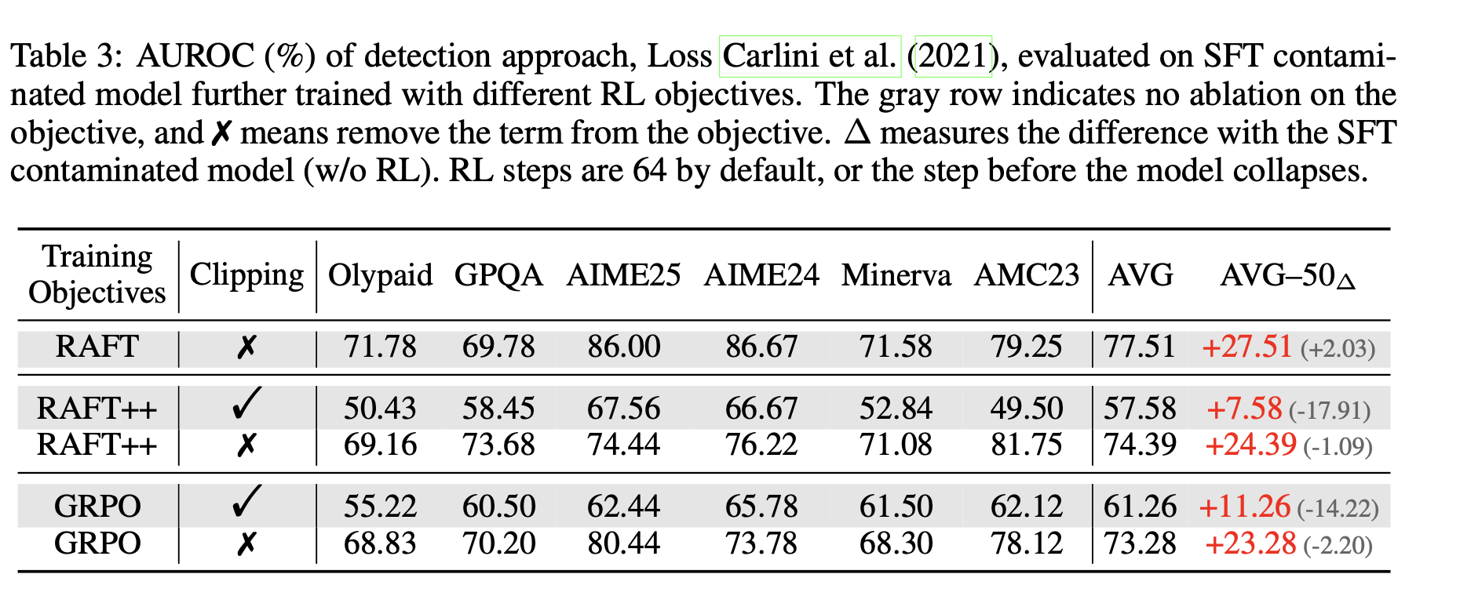
LRM Benchmark contamination
Empirical support for clipping factor

Slide 12
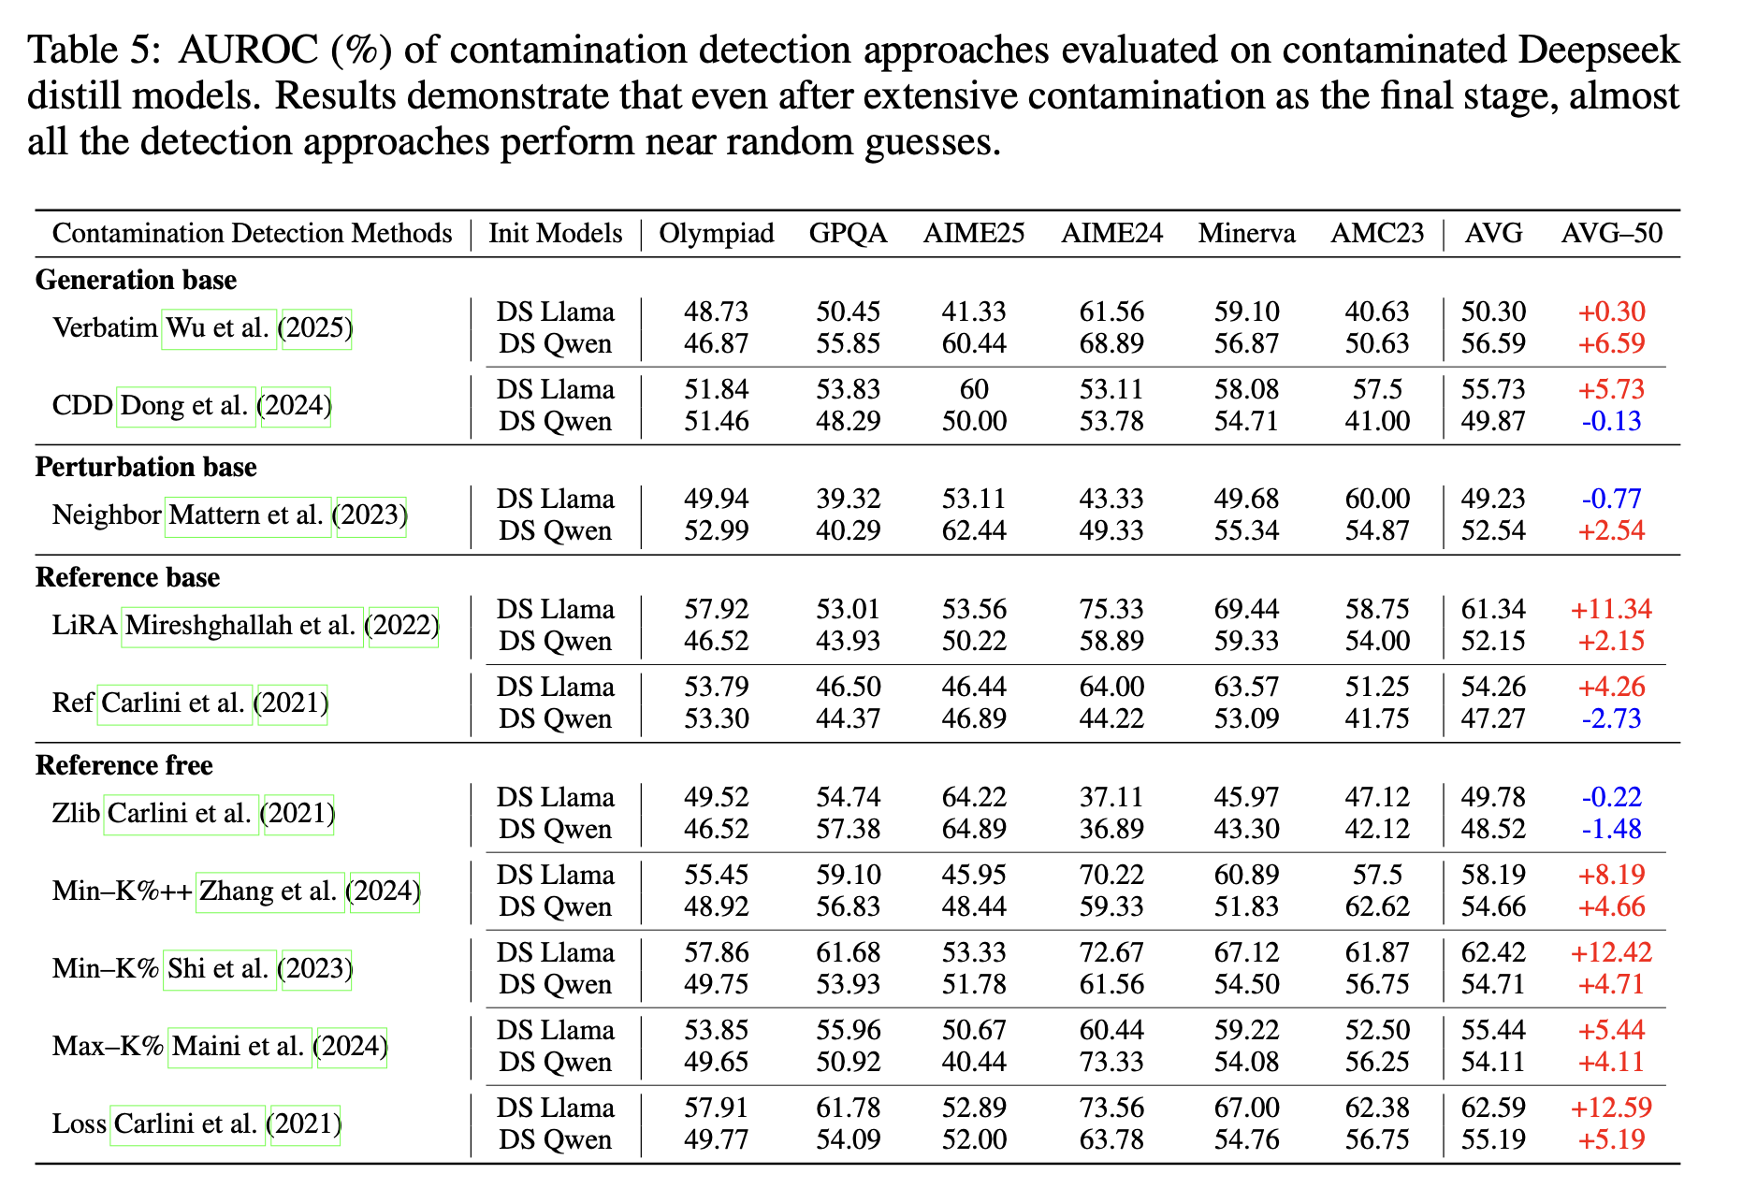
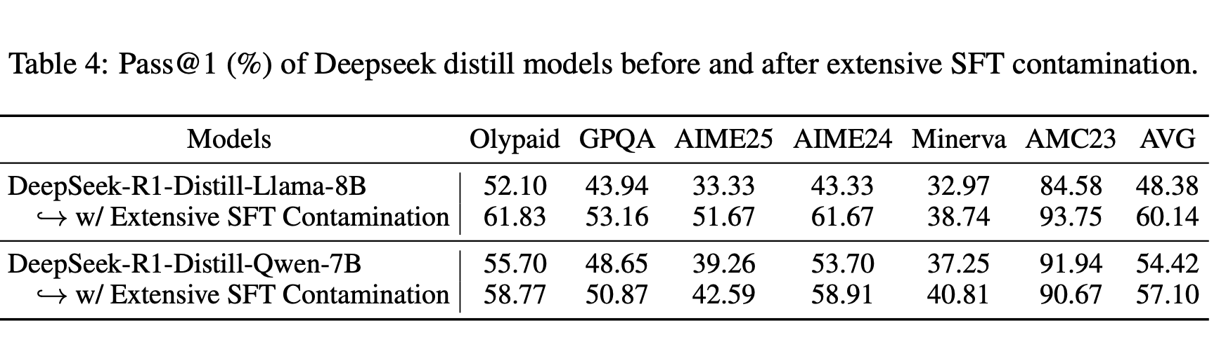
LRM Benchmark contamination
Finding 3: LRMs barely leave contamination evidence
Setting: We train the R1 distill models with 7 times of member set with SFT, and it improved the performance but detection rate was near random guess.

Slide 13
Ref
[0] https://www.heise.de/en/news/Meta-cheats-on-Llama-4-benchmark-10344087.html

